Slide 1
Intrinsic Semiconductors
In semiconductors and insulators, when an external electric field is applied the conduction is not possible as there is a forbidden gap, which is absent in metals.
In order to conduct, the electrons from the top of the full valence band have to move into the conduction band, by crossing the forbidden gap.
The field that needs to be applied to do this work will be extremely large.
Dr. S. RANJITH / Physics, SRM IST

Slide 2
Eg: Silicon where the forbidden gap is about 1 eV.
The distance between these two locations is about 1 Å (10⁻¹⁰ m).
A field gradient of approximately 1V/ (10⁻¹⁰ m) = 10¹⁰Vm⁻¹ is necessary to move an electron from the top of the valence band to the bottom of the conduction band.
Dr. S. RANJITH / Physics, SRM IST

Slide 3
The other possibility by which this transition can be brought about is by thermal excitation.
At room temperature, the thermal energy that is available can excite a limited number of electrons across the energy gap. This limited number accounts for semi-conduction.
When the energy gap is large as in diamond, the number of electrons that can be excited across the gap is extremely small.
Dr. S. RANJITH / Physics, SRM IST

Slide 4
In intrinsic semiconductors, the conduction is due to the intrinsic processes (without the influence of impurities).
A pure crystal of silicon or germanium is an intrinsic semiconductor. The electrons that are excited from the top of the valence band to the bottom of the conduction band by thermal energy are responsible for conduction.
The number of electrons excited across the gap can be calculated from the Fermi-Dirac probability distribution.
Dr. S. RANJITH / Physics, SRM IST

Slide 5
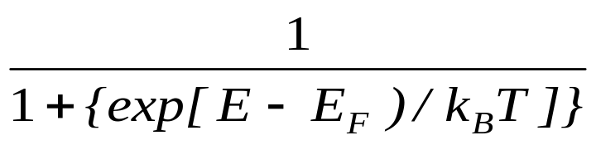
f(E) =
The Fermi level E_{F} for an intrinsic semiconductor lies midway in the forbidden gap.
The probability of finding an electron here is 50%, even though energy levels at this point are forbidden.
Then (E−E_{F}) is equal to E_{g} /2, where E_{g} is the magnitude of the energy gap.
Dr. S. RANJITH / Physics, SRM IST

Slide 6
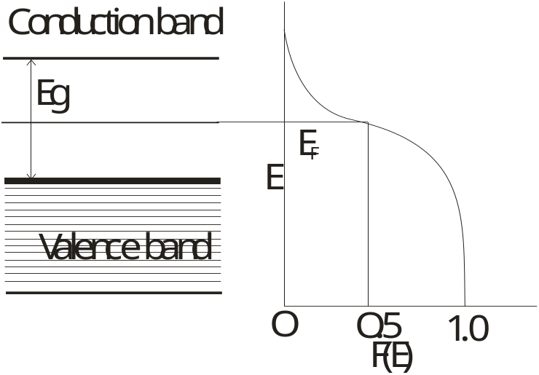
For a typical semiconductor like silicon, Eg = 1.1 eV, so that (E−E_{F}) is 0.55 eV, which is more than twenty times larger than the thermal energy k_{B}T at room temperature (=0.026 eV).
The Fermi level in an intrinsic semiconductor lies in the middle of the energy gap.
Dr. S. RANJITH / Physics, SRM IST

Slide 7
The probability f(E)of an electron occupying energy level
E becomes f(E) = exp(−E_{g} / 2k_{B}T ).
The fraction of electrons at energy E is equal to the probability f(E). The number n of electrons promoted across the gap, n = N exp(−E_{g} / 2k_{B}T)
where N is the number of electrons available for excitation from the top of the valence band.
Dr. S. RANJITH / Physics, SRM IST

Slide 8
The promotion of some of the electrons across the gap leaves some vacant electron sites in the valence band. These are called holes.
An intrinsic semiconductor contains an equal number of holes in the valence band and electrons in the conduction band, that is
n_{e} = n_{h}.
Under an externally applied field, the electrons, which are excited into the conduction band by thermal means, can accelerate using the vacant states available in the conduction band.
Dr. S. RANJITH / Physics, SRM IST

Slide 9
At the same time, the holes in the valence band also move, but in a direction opposite to that of electrons.
The conductivity of the intrinsic semiconductor depends on the concentration of these charge carriers, n_{e} and n_{h}.
In the case of metals, the drift velocity acquired by the free electrons in an applied field.
The mobility of conduction electrons and holes, μ_{e} and μ_{h}, as the drift velocity acquired by them under unit field gradient.
Dr. S. RANJITH / Physics, SRM IST

Slide 10
The conductivity σ of an intrinsic semiconductor as
σ_{i} = n_{e} e μ_{e} + n_{h} e μ_{h}
where e is the electronic charge, n_{e} and n_{h} are concentrations of electrons and holes per unit volume.
Dr. S. RANJITH / Physics, SRM IST

Slide 11
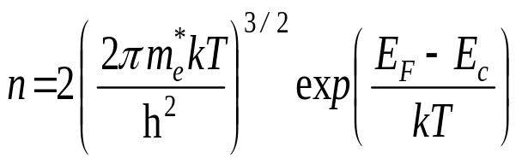
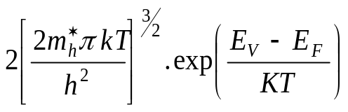
Fermi level
The number of free electrons per unit volume in an intrinsic semiconductor is
The number of holes per unit volume in an intrinsic semiconductor is
p =
Since n = p in intrinsic semiconductors.
Dr. S. RANJITH / Physics, SRM IST

Slide 12
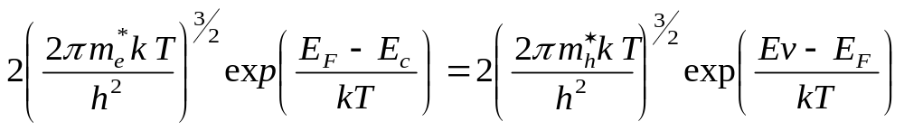
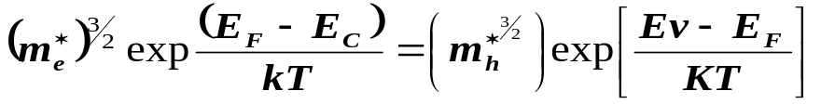
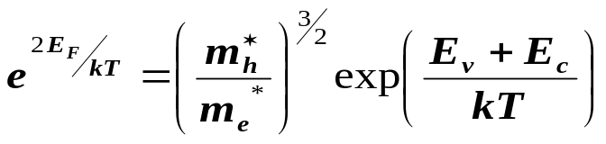
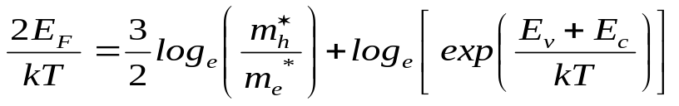
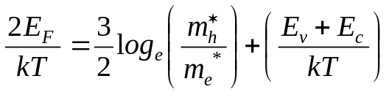
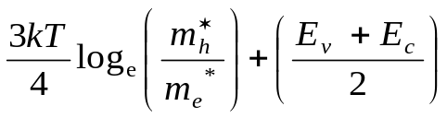
Taking log on both sides,
or E_{f} =
Dr. S. RANJITH / Physics, SRM IST

Slide 13
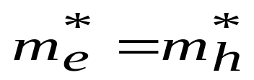
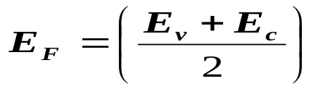
If we assume that,
[ since log_{e}1 = 0]
Thus, the Fermi level is located half way between the valence and conduction band and its position is independent of temperature. Since m_{h}* is greater than m_{e}*, E_{F} is just above the middle, and rises slightly with increase in temperature
Dr. S. RANJITH / Physics, SRM IST

Slide 14
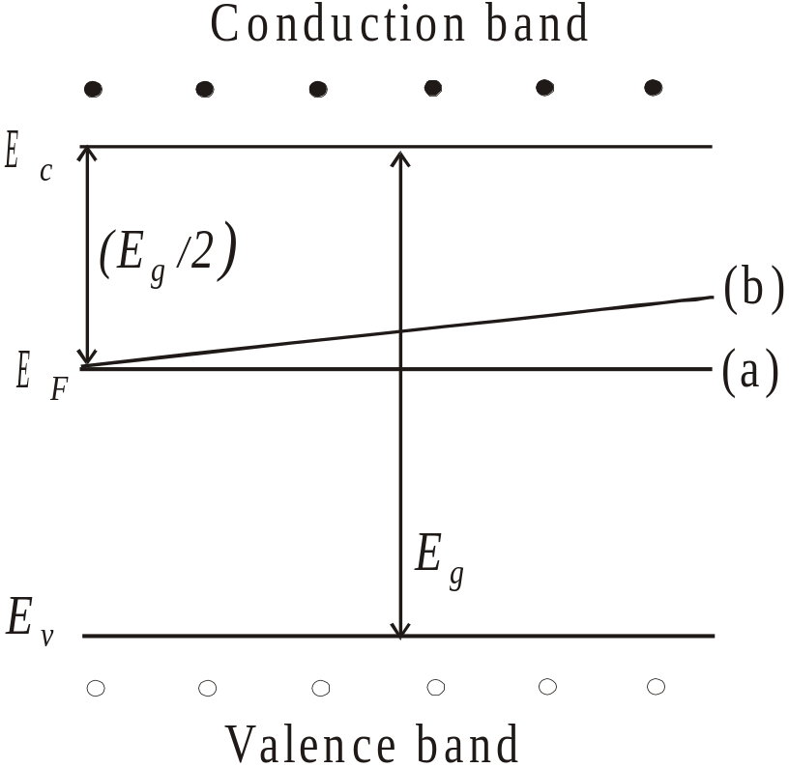
Position of Fermi level in an intrinsic semiconductor at various temperatures
(a) at T = 0 K, the Fermi level in the middle of the forbidden gap
(b) as temperature increases, E_{F} shifts upwards
Dr. S. RANJITH / Physics, SRM IST

